Slide 1
HackShield
A Cybersecurity Solution for Threat Detection & Data Protection
By- Himanshu Khatri (068)

Slide 2

Introduction
HackShield is a cutting-edge tool designed to enhance cybersecurity by detecting threats, securing files, and monitoring networks in real-time.

Slide 3
01
Threat Overview

Slide 4
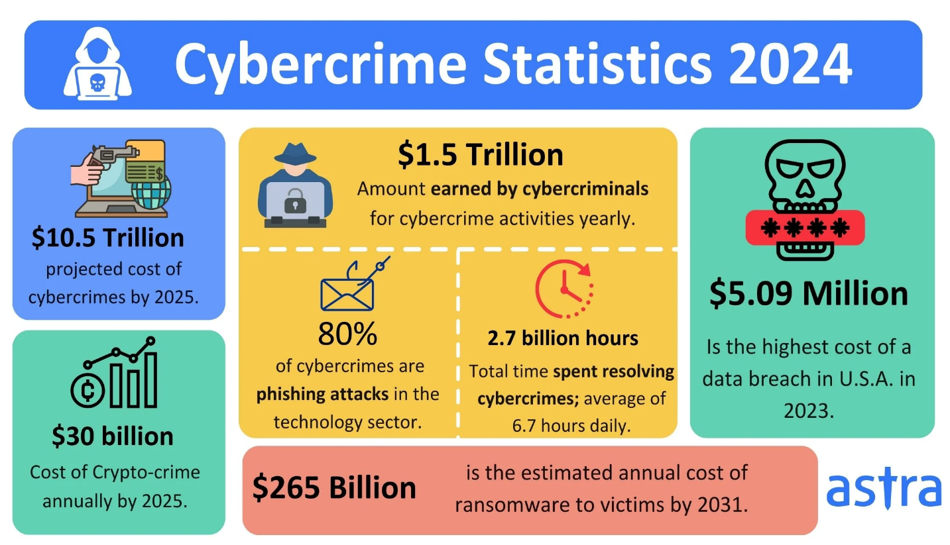
Rise in cyberattacks
Cyberattacks have significantly increased in frequency and complexity, endangering sensitive information and organizational integrity. Every year, the number of incidents rises steeply, showing that hackers are continuously adapting and improving their strategies.

Slide 5
Malware and ransomware
Malware, including ransomware, has become one of the leading causes of data breaches. These malicious software types can lock users out of their systems and demand ransom, or steal sensitive data leading to substantial financial losses.

Slide 6

Need for effective solutions
As cyber threats evolve, existing security measures often fall short. Businesses require solutions that are cost-effective, user-friendly, and capable of real-time detection to safeguard against increasing cyber risks and data breaches.

Slide 7
02
Key Features

Slide 8

Malware detection
HackShield uses advanced algorithms and database checks to accurately detect malware. It analyzes file signatures and behaviors, enabling it to identify and neutralize threats before they cause harm, ensuring that files remain safe and secure.

Slide 9

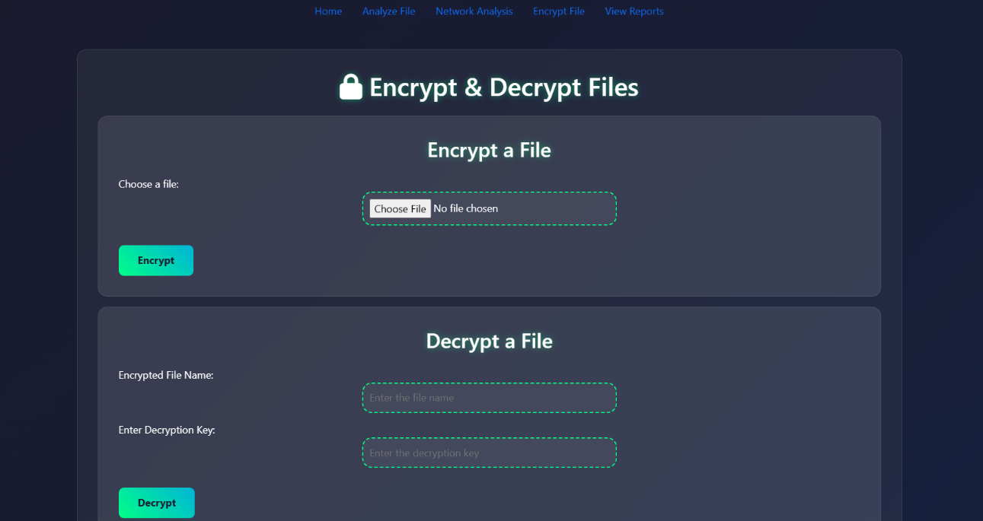
File encryption
HackShield provides robust file encryption capabilities, ensuring that sensitive data is rendered unreadable to unauthorized users. This includes generating unique keys for decryption, protecting user data even if the files are intercepted during transmission.

Slide 10
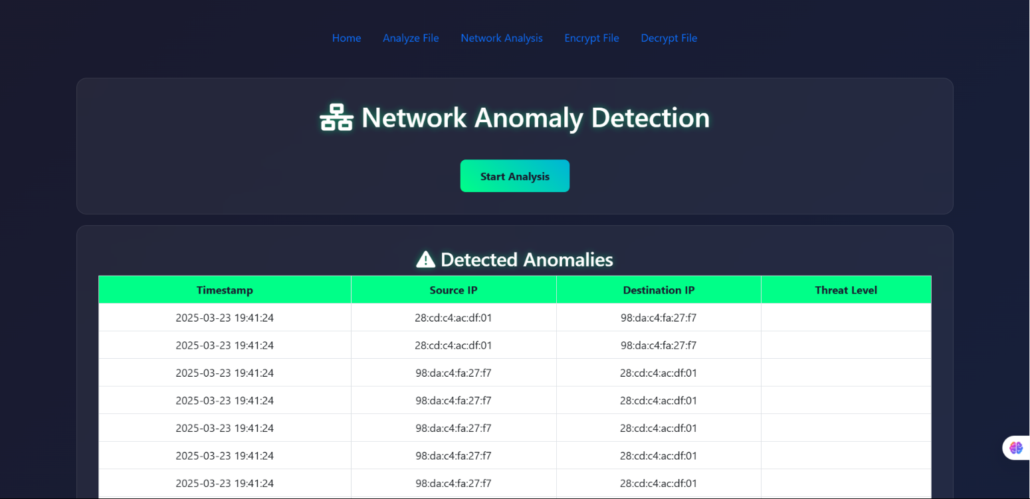
Network monitoring
Real-time network monitoring in HackShield detects anomalous activity by capturing and analyzing live traffic. It alerts users to potential threats and malicious IPs, allowing for immediate action to be taken to protect the network infrastructure.

Slide 11
Conclusions
HackShield represents a significant step towards comprehensive cybersecurity. By providing effective malware detection, secure file encryption, and thorough network monitoring, it helps organizations protect their data and maintain operational integrity against growing cyber threats.

